Slide 1
Automation Build with Maven
Trainer:
Notes:
Course Review Committee:
Review Date:

Slide 2
Warm up - Introductions
Positions
Years experience on DevOps Development.
Learners can acquired maven build and automation process.

Slide 3
Course Objectives
At the end of the course, you will have acquired sufficient knowledge to:
Using Maven with advance knowledge of configurations.
Understanding automation build process with maven.

Slide 4
Agenda
Introduction to Maven
Using Maven (Getting started)
Maven principles detail

Slide 5
Course Audience and Prerequisite
The course is for JAVA developers.
The following are prerequisites:
JAVA fundamentals.
J2EE basic experience.
Software development process experience.
No other course is required.

Slide 6
Assessment Disciplines
Exercise: <50%>
Final Exam: <50%>
Passing Scores: <70%>

Slide 7
Duration and Course Timetable
Course Duration: <3 hrs>

Slide 8
Further References
Maven Home: http://maven.apache.org/
Guides: http://maven.apache.org/guides/
Build lifecycle: http://maven.apache.org/guides/introduction/introduction-to-the-lifecycle.html
Articles: http://maven.apache.org/articles.html
…

Slide 9
Set Up Environment
To complete the course, your PC must install:
Eclipse
Maven
This slide with sample codes
Connect to Internet or local Maven repository.

Slide 10
Course Administration
In order to complete the course you must:
Sign in the Class Attendance List
Participate in the course
Provide your feedback in the End of Course Evaluation
Complete exercises and mini-test

Slide 11
Introduction
Notes:
WHAT – WHEN – WHERE – WHY

Slide 12
General approach
What is Maven?
Where is Maven in the development process?
Why use Maven?
How can Maven do that?

Slide 13
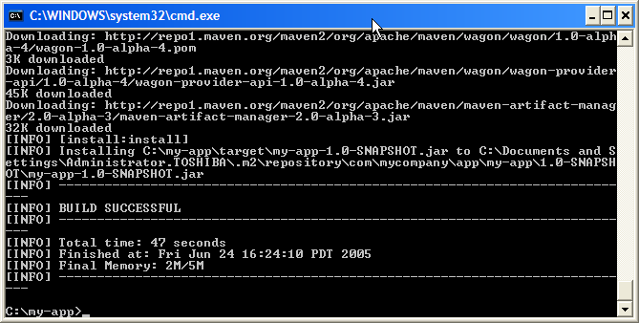
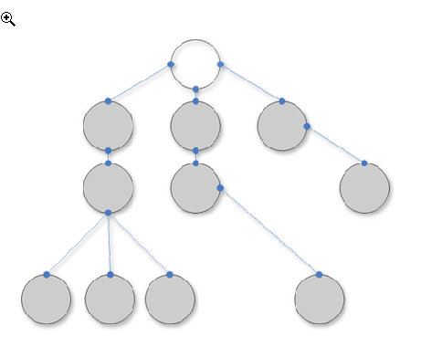
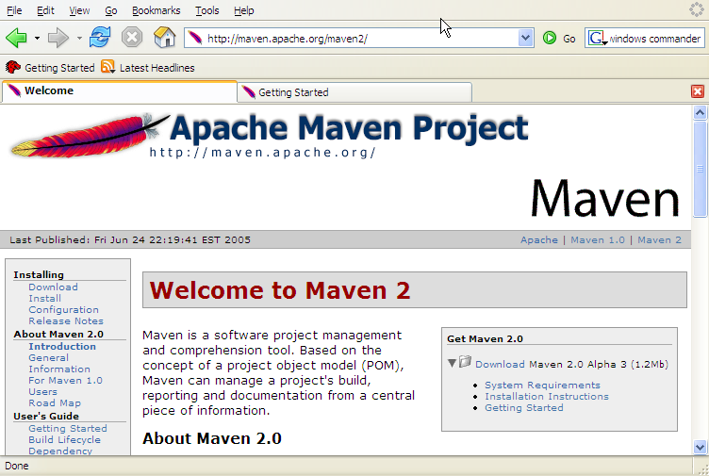
What is Maven?
A build tool
A dependency management tool
A documentation tool

Slide 14
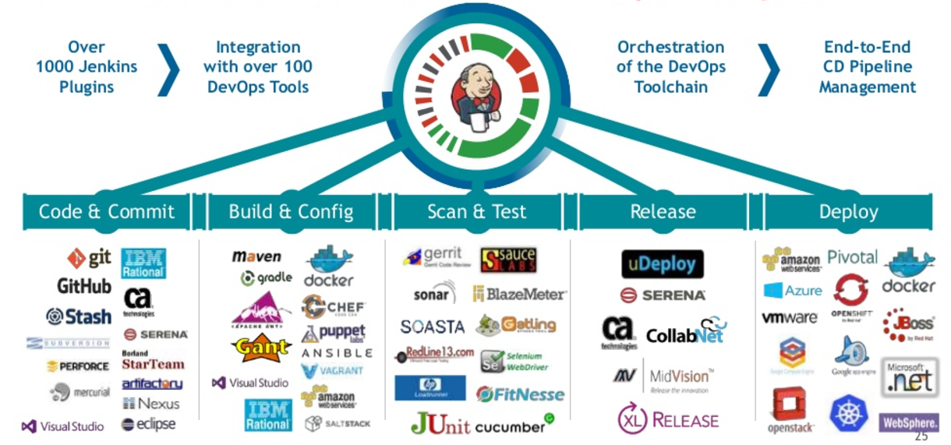
Where is Maven?

Slide 15
Maven benefits (Why use Maven?)
Making build process much easier.
Managing dependencies.
Centralizing module dependency.
Maintaining a standard project layout.
Generating report on broken code, broken coding convention, unit test code coverage, …

Slide 16
Maven’s Principles (How can Maven do that?)
Convention over configuration
Standard directory layout for projects
Standard naming conventions
Declarative execution:
using Maven's Project Object Model (POM)
The execution of Maven's plug-ins is coordinated by Maven's build life cycle in a declarative fashion with instructions from Maven's POM.
Reuse of build logic
Separate building logic into coherent modules.
Everything accomplished in Maven is the result of a plugin executing. Plugins are the key building blocks for everything in Maven.
Coherent organization of dependencies
Automatically locates dependencies from remote and local repositories.

Slide 17
Using Maven
Getting Started
Notes:
Course Review Committee:
Review Date:

Slide 18
Install Maven
Step 1 - verify Java installation on your machine
Step 2 - set JAVA environment - set the JAVA_HOME environment variable
Step 3 - download Maven2 from
http://maven.apache.org/
apache-maven-3.5.0-bin.zip
Step 4: Extract the Maven archive
Step 5: Set Maven environment variables
Add M2_HOME, M2, MAVEN_OPTS to environment variable
For example: Set the environment variables using system properties. M2_HOME=C:\Program Files\Apache Software Foundation\apache-maven-3.5.0
MAVEN_OPTS=-Xms256m -Xmx512m

Slide 19
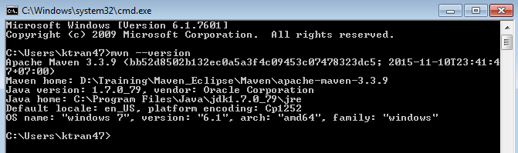
Install Maven
Step 6: Add Maven bin directory location to system path
%M2_HOME%\bin
Step 7: Verify Maven installation
execute the following mvn command.
mvn –version

Slide 20
Create a new maven project
Maven uses archetype plugins to create projects. To create a simple java application, we'll use maven-archetype-quickstart plugin
mvn archetype:generate
-DgroupId=com.companyname.insurance
-DartifactId=cscv
-DarchetypeArtifactId=maven-archetype-quickstart
-DinteractiveMode=false

Slide 21
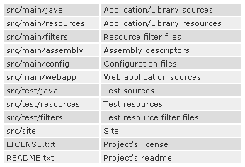
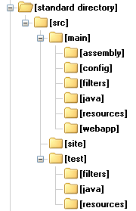
Maven Standard Directory

Slide 22
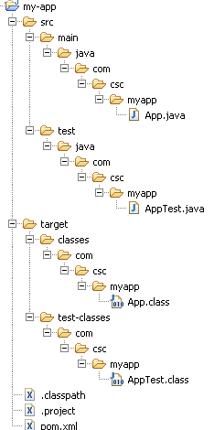
Maven - Build & Test Project
Go to directory where you've created your java application
mvn compile
mvn package
Generated classes and resources after compile

Slide 23
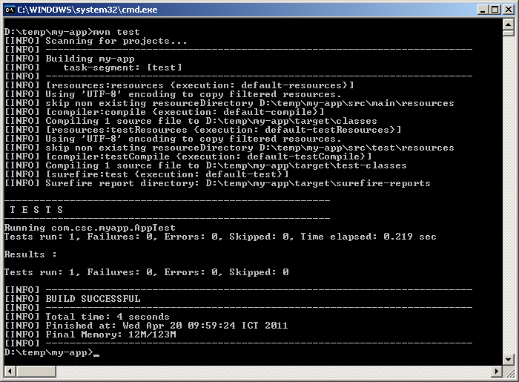
Running unit test on maven project
mvn test
Maven auto build before test
Test and Report

Slide 24
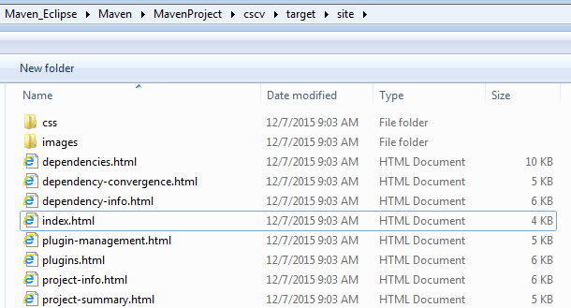
Maven - Project Documents
Create documentation of the application in one go
Go to the directory where you had created your java project, execute the following mvn command.
mvn site

Slide 25
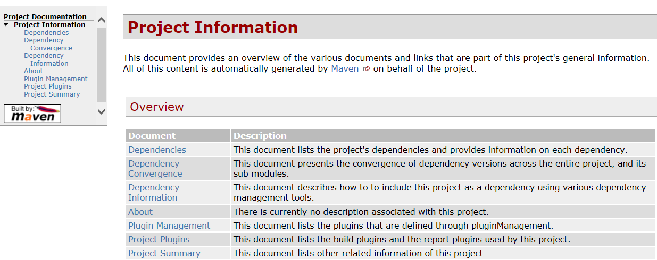
Maven - Project Documents

Slide 26
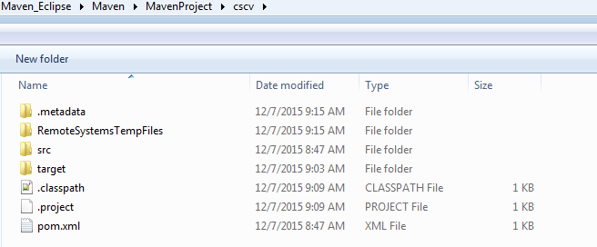
Convert Maven based Java Project to support Eclipse IDE
Go to the directory where you had created your java project, execute the following mvn command.
mvn eclipse:eclipse
Verify Java Project
You will see two new files are created – “.classpath” and “.project“. Both files are created for Eclipse IDE.

Slide 27
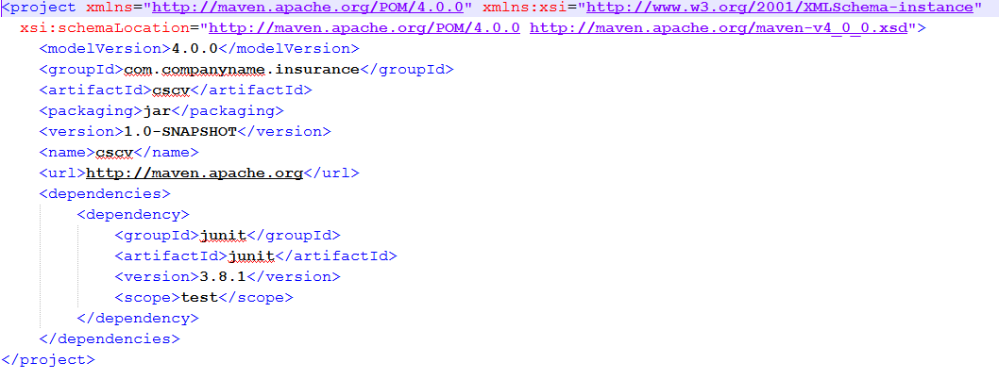
Maven - POM
POM stands for Project Object Model
It is fundamental Unit of Work in Maven.
It is an XML file.
It always resides in the base directory of the project as pom.xml.
Example POM

Slide 28
Maven - POM
There is a single POM file for each project.
All POM files require the project element and three mandatory fields: groupId, artifactId,version.
Projects notation in repository is groupId:artifactId:version.
Root element of POM.xml is project

Slide 29
Maven - Build Life Cycle
A Build Lifecycle is a well defined sequence of phases which define the order in which the goals are to be executed
Clean Lifecycle
Default (or Build) Lifecycle
This is the primary life cycle of Maven and is used to build the application.
There are 23 phases. Example phrase.
validate - Validates whether project is correct and all necessary information is available to complete the build process.
generate-sources - Generate any source code to be included in compilation phase.
generate-resources - Generate resources to be included in the package.
package Take the compiled code and package it in its distributable format, such as a JAR, WAR, or EAR file.
compile - Compile the source code of the project.
Site Lifecycle

Slide 30
Maven - Plug-ins
Maven is actually a plugin execution framework where every task is actually done by plugins.
A plugin generally provides a set of goals and which can be executed using following syntax: mvn [plugin name]:[goal name]
Example: mvn compiler:compile
Maven provided following two types of Plugins:
Build plugins - configured in the <build/> element of pom.xml
Reporting plugins - configured in the <reporting/> element of the pom.xml

Slide 31
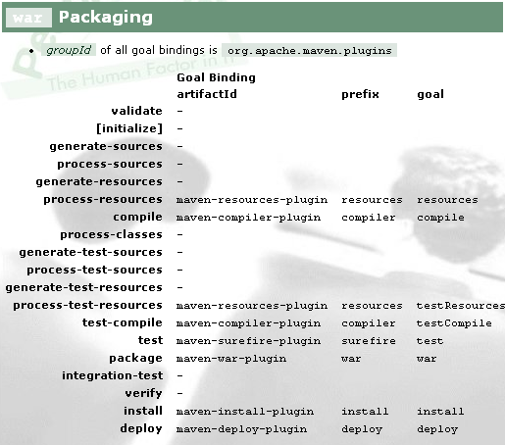
Maven - Plug-ins

Slide 32
Exercise
10 minutes
Create a new project with name {trainee-name}
Use Maven to generate Eclipse project
Write simple “HelloWorld” class which print out {trainee-name}
Write simple unit test “HelloWorldTest” using JUnit4
Submit project to trainer

Slide 33
Maven Principles Detail
Notes:
Course Review Committee:
Review Date:

Slide 34
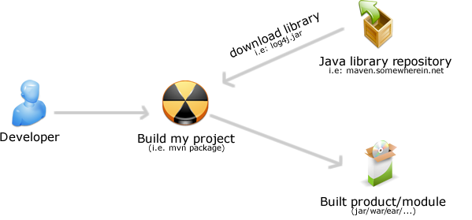
Maven - Manage Dependencies
One of the core features of Maven is Dependency Management

Slide 35
Maven - Manage Dependencies
Maven uses binary dependencies from local and remote repositories transparently from user’s view.
A
B
<dependencies> <dependency> <groupId>com.acme</groupId> <artifactId>B</artifactId> <version>1.0</version> <scope>compile</scope> </dependency> </dependencies>
C
Artifact
Repository
(Local)
Artifact
Repositories
(Remote)
Build C
Look for A & B
Look for A & B

Slide 36
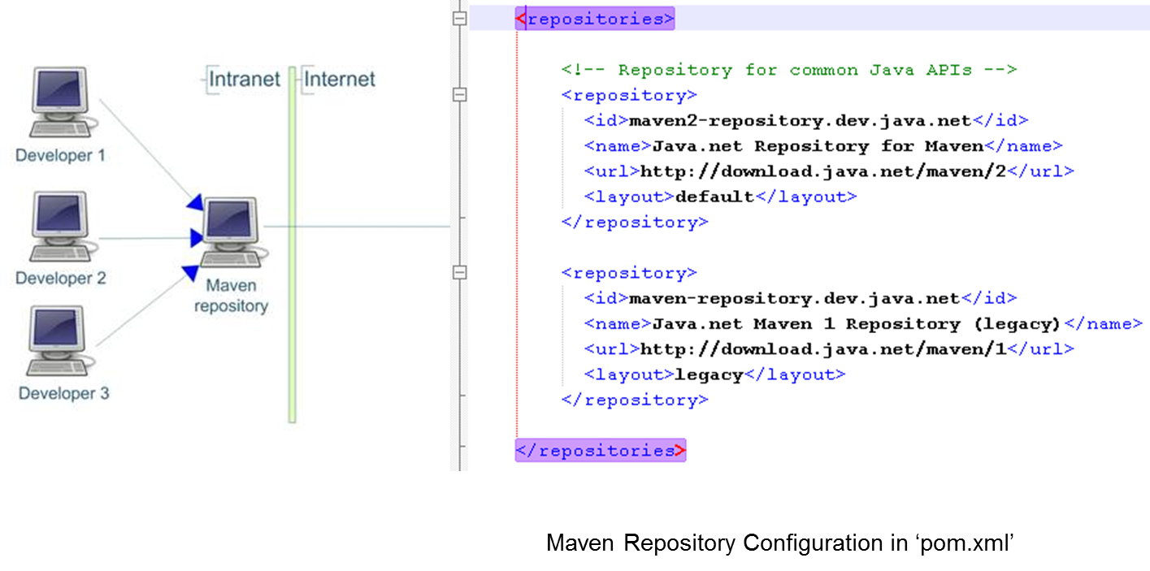
Maven Repositories
A repository is a place i.e. directory where all the project jars, library jar, plugins or any other project specific artifacts are stored
Can be used by Maven easily.

Slide 37
Maven Repositories
Maven repository are of three types : local, central, remote.
Local Repository
Maven local repository is a folder location on your machine. It gets created when you run any maven command for the first time. Maven local repository keeps your project's all dependencies (library jars, plugin jars etc)
Central Repository
It is repository provided by Maven community
It contains a large number of commonly used libraries
When Maven does not find any dependency in local repository, it starts searching in central repository.
When dependency in central repository is not found, it will search dependency in remote repository.

Slide 38
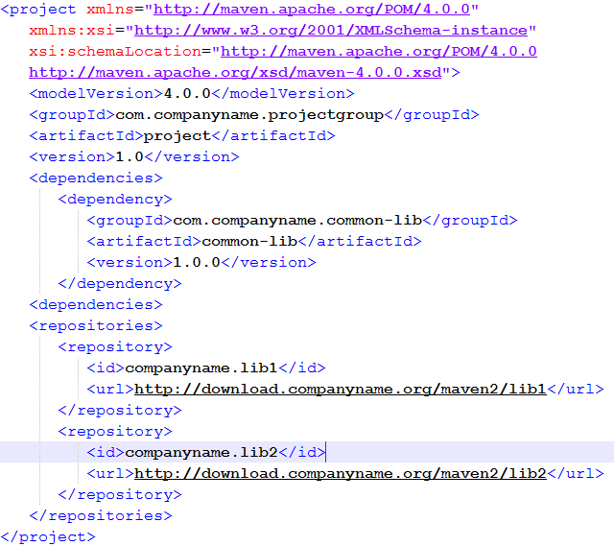
Maven Repositories
Remote Repository
Maven does not find a mentioned dependency in central repository as well then it stopped build process and output error message to console. To prevent such situation, Maven provides concept of Remote Repository which is developer's own custom repository containing required libraries or other project jars.

Slide 39
Dependency scopes
compile - This scope indicates that dependency is available in classpath of project. It is default scope.
provided - This scope indicates that dependency is to be provided by JDK or web-Server/Container at runtime
The Servlet API JAR is in this scope
test - Dependency is made available only at test time
This scope is appropriate for JUnit.
runtime - This scope indicates that dependency is not required for compilation, but is required during execution.
system - Like “provided” but you have to provide the system path

Slide 40
Maven - Snapshots
<project>
[...]
<version>1.0-SNAPSHOT</version>
[...]
</project>
While developing multiple modules, modules are in flux (usually change).
A snapshot in Maven is an artifact that has been prepared using the most recent sources available.
Maven checks for a new SNAPSHOT version in a remote repository and will automatically fetch the latest SNAPSHOT for every build (transparent to user).

Slide 41
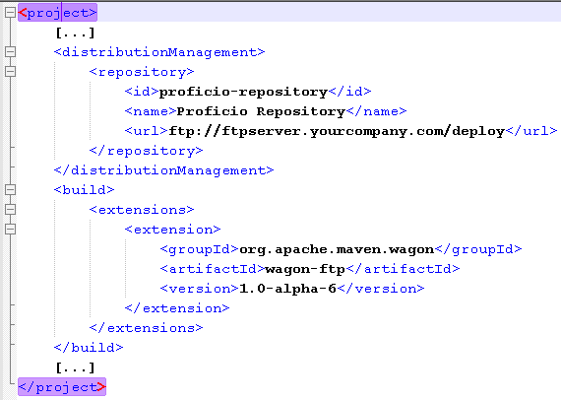
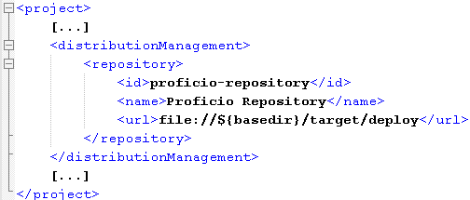
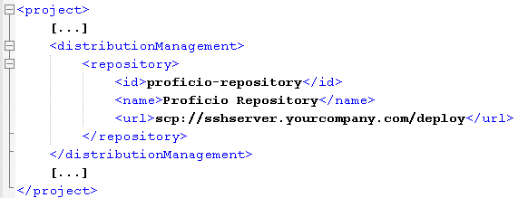
Deploying your Application
Deploying with FTP
mvn deploy
Deploying to the File System
Deploying with SSH2

Slide 42
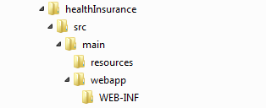
Maven - Web Application
To create a simple java web application, we'll use maven-archetype-webapp plugin. Execute the following mvn command.
mvn archetype:generate
DgroupId=com.companyname.insurance
DartifactId=healthInsurance
DarchetypeArtifactId=maven-archetype-webapp
DinteractiveMode=false
You'll see a java application project created named
healthInsurance

Slide 43
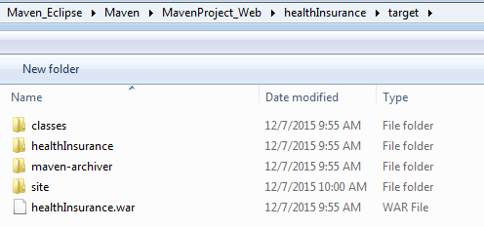
Maven - Web Application
Build Web Application
Execute the following mvn command.
mvn clean package
A war file is created in target folder.

Slide 44
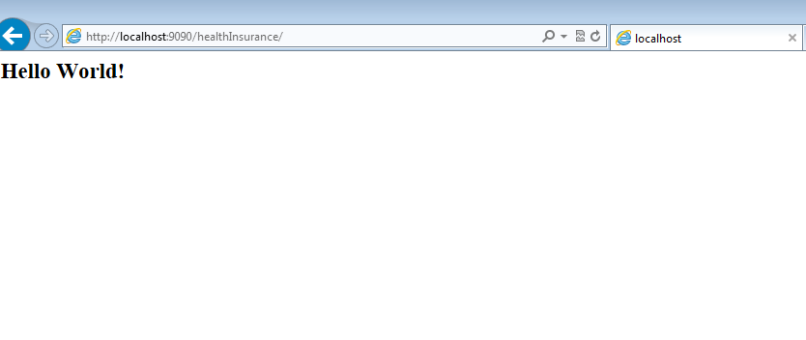
Maven - Web Application
Deploy Web Application by using Tomcat. Start webserver and verify output.

Slide 45
Maven - How to deploy Maven Base War file to Tomcat
Tomcat 7
Deploy URL = http://localhost:8080/manager/text
Command = mvn tomcat7:deploy
Tomcat 6
Deploy URL = http://localhost:8080/manager/
Command = mvn tomcat6:deploy

Slide 46
Maven - How to deploy Maven Base War file to Tomcat
Configure Tomcat
%TOMCAT7_PATH%/conf/tomcat-users.xml
<tomcat-users>
<role rolename="manager-gui"/>
<role rolename="manager-script"/>
<user username="admin" password="password" roles="manager-gui,manager-script" />
</tomcat-users>

Slide 47
Maven - How to deploy Maven Base War file to Tomcat
Configure Maven settings.xml
%MAVEN_PATH%/conf/settings.xml
<settings ...>
<servers>
<server>
<id>TomcatServer</id>
<username>admin</username>
<password>password</password>
</server>
</servers>
</settings>

Slide 48
Maven - How to deploy Maven Base War file to Tomcat
Add Maven plugin to POM file
<project>
…
<build>
<plugins>
<plugin>
<groupId>org.apache.tomcat.maven</groupId>
<artifactId>tomcat7-maven-plugin</artifactId>
<version>2.2</version>
<configuration>
<url>http://localhost:8080/manager/text</url>
<server>TomcatServer</server>
<path>/healthInsurance</path>
</configuration>
</plugin>
</plugins>
</build>
</project>

Slide 49
Points to Remember
Notes:
Course Review Committee:
Review Date:

Slide 50
Review Maven flow
JAR artifact
JAR Dependency
Plugin Dependency
Remote Repository
3’
Plugin artifacts
Local Repository
pom.xml
<project>
…
</project>
3
project
Plugin Dependency
Maven Core
2
src/…
POM
JAR Dependency
1
Plugin artifacts
JAR artifacts
target
4
target/classes/…
JAR artifact
Maven Lifecycle
process-resources
compile
package
install
deploy
generated
libraries
…

Slide 51
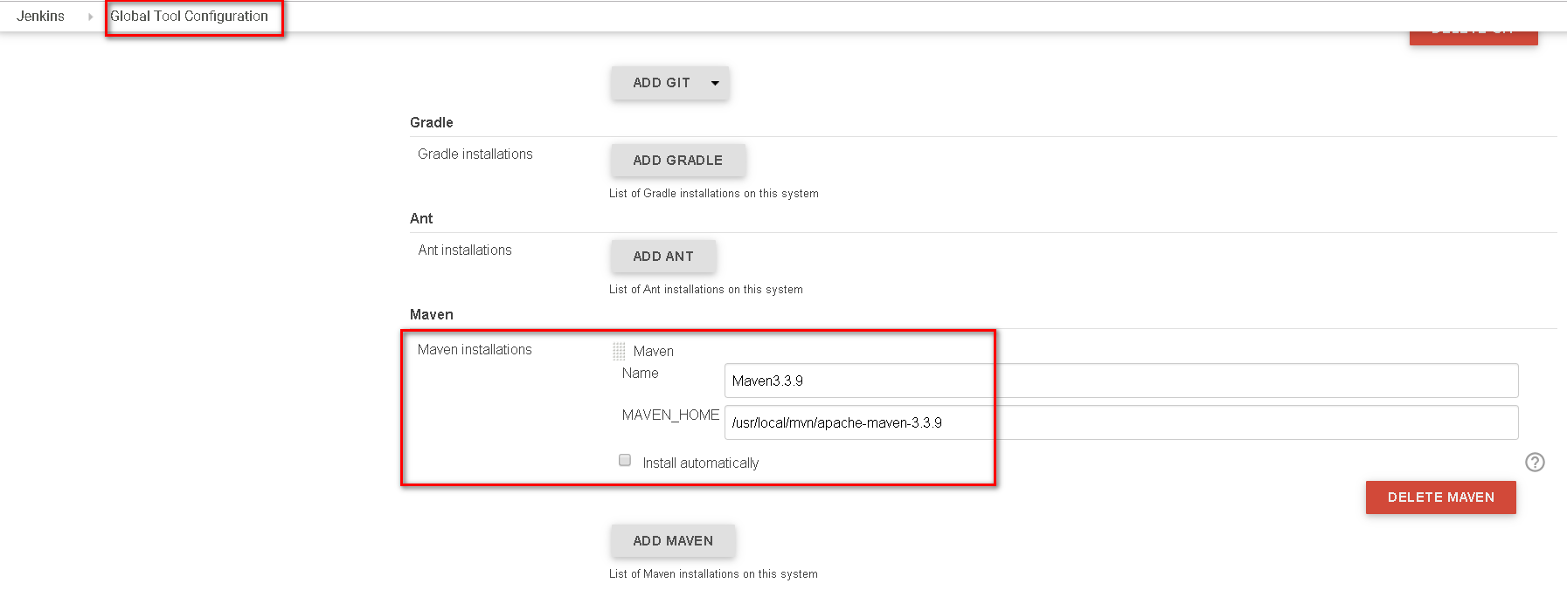
Maven Plugin in Jenkins

Slide 52
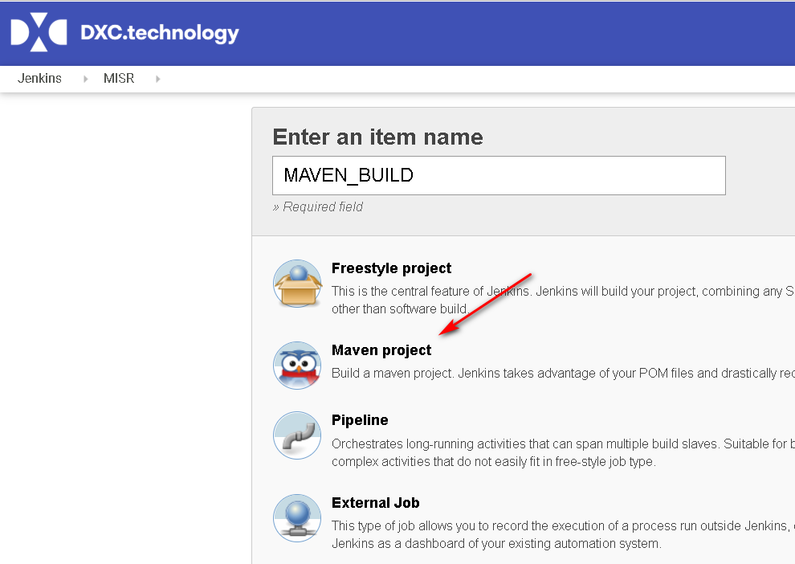
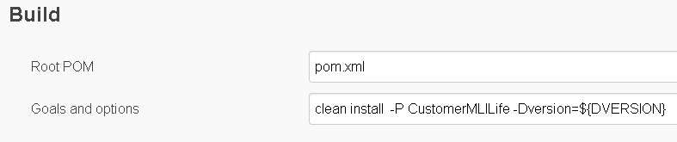
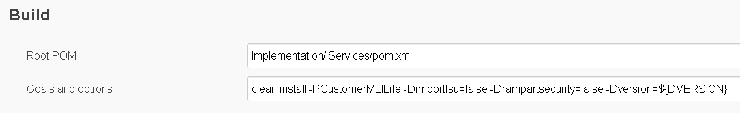
Maven Jenkins Jobs

Slide 53
Exercise
Creating a web-app project with name {trainee-name}-webapp
Deploying sample MBRDATA service to Tomcat or Jboss

Slide 54
Questions & Answer
Notes:
Course Review Committee:
Review Date:

Slide 55
Sample Exam Questions
What POM stands for?
Which Maven command can be used to create a new project on an archtype?
Which Maven command generate Eclipse project with classpath and settings accordingly?
Which dependency scope is made available only at test time ?

Slide 56
Thank You!
Notes:
Course Review Committee:
Review Date:

